Slide 1




Slide 2


Agenda
About Potion
Technical Requirements & System Flow
Execution
History

Slide 3
About Potion

Slide 4
What is Potion?
The in-house recommender system enhances personalized experiences by providing an API endpoint that returns a specified number of product recommendations based on user data and requested product count. These recommendations are delivered through emails, which display the tailored product suggestions for each user.
Sephora utilizes Marketing Cloud to send emails to its subscribers. To integrate personalized product recommendations seamlessly, Potion has been developed as a Dynamic Content Block within Marketing Cloud. By including Potion’s Dynamic Content Block in an email, each email can feature personalized product recommendations.
A potential issue with this approach is that API calls made during email sends could delay the email build process in Marketing Cloud, adversely affecting performance. To mitigate this, the API call is executed in Automation Studio to pre-collect product recommendations, ensuring no delays occur during the email build.

Slide 5
Technical Requirements

Slide 6
Technical Requirements
Create automation
Create script that communicates with the Potion API and store the return in the Potion DE
Make the script API communication a batch by batch process so the API communication will not reach the API call threshold.
Have fields like cardNumber, payload, created_date, and updated_date that will be used in the DCB.
Create DCB for email
Pull the payload from Potion DE according to the recipient’s cardNumber.

Slide 7
Execution

Slide 8
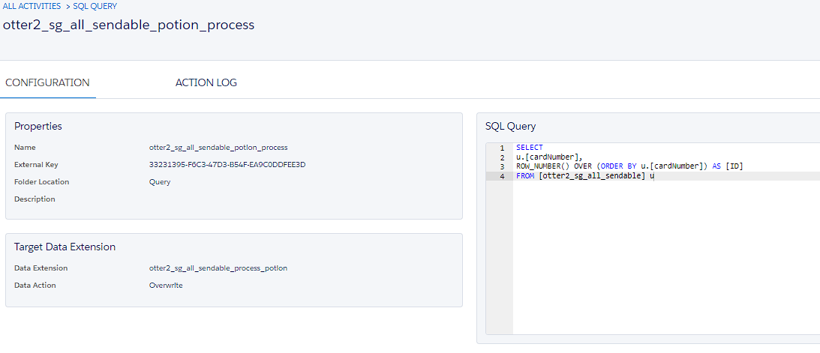
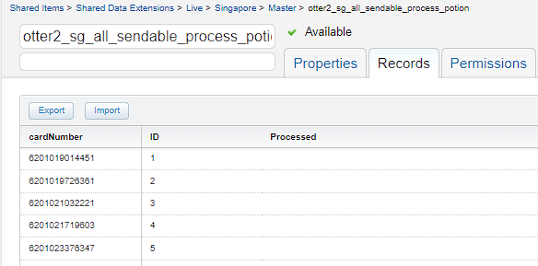
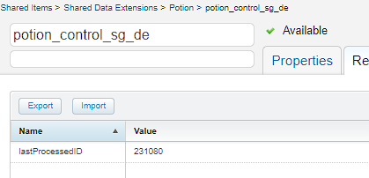
Automation - Sendable Duplication Query
To handle the batch API communication process, the Potion API endpoint requires the user's card number to provide specific recommendations. A reference Data Extension (DE), otter2_xx_all_sendable, is used to ensure only active users are processed, excluding those who do not need processing. The card numbers from this DE are copied to a new DE, otter2_xx_all_sendable_process_potion, which is utilized in the batch processing script. This DE contains the user's card number and an ID that serves as a tracker for the batch process.
Given the batch-by-batch nature of the script, it needs to track its progress. A new DE, potion_control_xx_de, has been created for this purpose. The script uses this DE to determine where it stopped and to continue from that point in the next batch.
The script will trigger the query to run when potion_control_xx_de is empty or when all data in otter2_xx_all_sendable_process_potion has been processed.

Slide 9
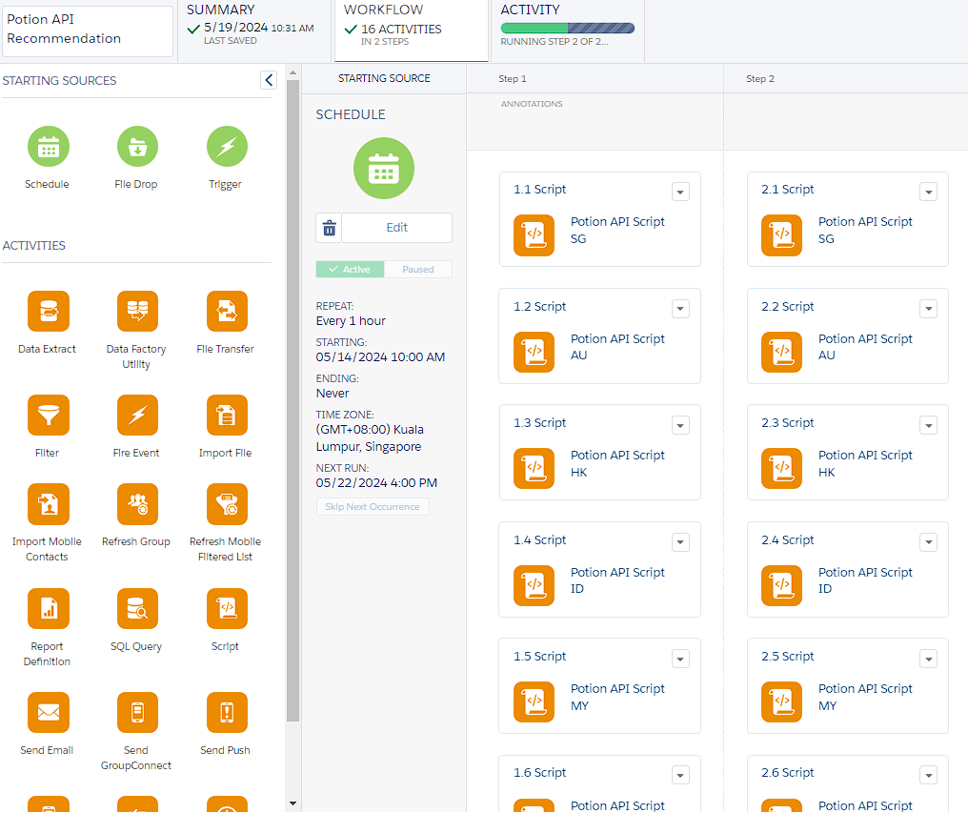
Script Performance
There are total of 8 markets that the script is processing:
Australia: 700k+
Hong Kong: 80k+
Indonesia: 300k+
Malaysia: 400k+
Singapore: 300k+
New Zealand: 100k+
Philippines: 100k+
Thailand: 200k+
Total would be around: 2.2M
The script's batch process is set to 500 records per batch and 1,500 records per run, meaning the API communication process will run three times for each market per run.
Script Process: 1,500 records in approximately 30 minutes
8 Markets: 12,000 records in approximately 30 minutes
Automation: 2 script runs (24,000 records) in less than 1 hour
To process the entire 2.2 million records, it will take nearly 4 days. However, markets with smaller volumes will complete much faster and will restart the loop for the update process.

Slide 10
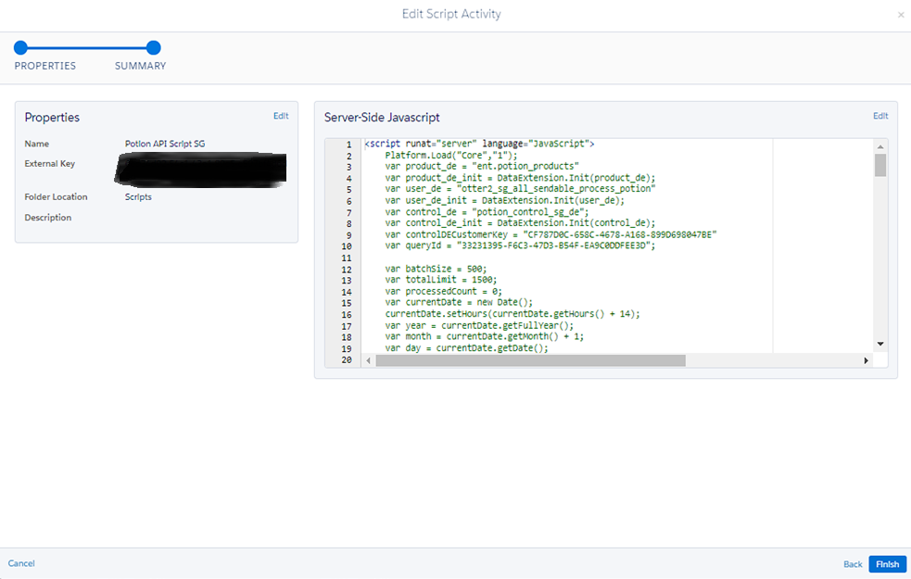
Automation
Handles the batch by batch API communication process and stores the data that’s being pulled from Potion API Endpoint to the Potion DE.
Business Unit: Parent
Name: my automations / Potion API / Potion API Recommendation
DE: Shared Items > Shared Data Extensions > Potion > potion_products

Slide 11
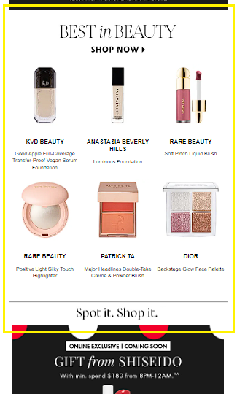
Dynamic Content Block
Contains the payload of recommendations object that will be displayed in the DCB.
Sample API Return
Potion DE
DCB
{
"recommendations": [
{
"item": {
"product_id": "24545",
"sale_text": "",
"brand": "DIOR",
"sku": "43398",
"name": "Addict Lip Tint",
"rating": 4.05,
"price": "700000.0",
"crossed_price": "",
"product_slug": "dior-dior-addict-lip-tint",
"variant": "641 Natural Red Tangerine ",
"brand_url": "https://www.sephora.co.id/brands/dior",
"under_sale": false,
"image_url": "https://image-optimizer-id.production.sephora-asia.net/images/product_images/default_3348901602792_DIOR_ADDICT_LIP_TINT_641_NATURAL_RED_TANGERINE_WITHOUT_SHADOW_3aba841bae441f5d62ee499b5984ba7d5b603b80_1705372985.png",
"variant_uri": "/products/dior-dior-addict-lip-tint/v/641-natural-red-tangerine",
"tag": ""
}
}
],
"recommendation_id": "potion-c72166511de04254a772a62aeda6313b",
"success": "True"
}
cardNumber
payload
created_date
updated_date

Slide 12
Locations
Automation
Business Unit: Parent
Name: my automations / Potion API / Potion API Recommendation
DE: percy_offers_details
Dynamic Content Block
Business Unit: Singapore
Name: Content Builder > Dynamic_Content_Blocks > Active DCB > API Call > sg_dcb_apirecommender_6

Slide 13
History

Slide 14
Issues Resolved
Issues | Resolution
Initially, there is no batch processing; API communication occurs in real-time within the campaign. Each campaign build involves a DCB that interacts with the Potion API Endpoint to display product recommendations based on the response. However, this process have resulted to a send time delay of up to 7 hours. | A script was created to process the Product Recommendations and store the data into the DE. The campaign then pulls the payload from the DE and displays it within the campaign.
The first resolution encountered an issue due to the API threshold being limited to 4,000 requests per minute. This limitation caused the script to frequently encounter errors. | A batch process was implemented into the script by using a control DE to track the runs and a Potion DE to contain the payload.

Slide 15

THAT’S IT! THANK YOU!

